Slide 1
MEASURE ENERGY CONSUMPTION

Slide 2
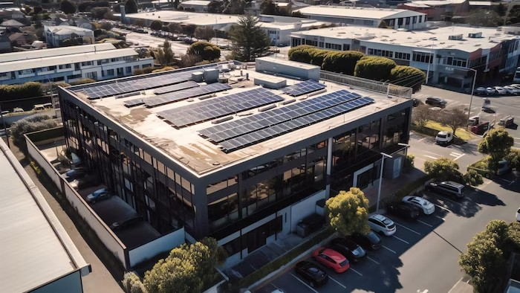
Introduction
Welcome to our presentation on Optimizing Energy Efﬁciency. In this presentation, we will discuss strategies for measuring and reducing energy consumption. We will explore various techniques and technologies that can help organizations achieve their energy efﬁciency goals. Let's get started!

Slide 3

Understanding Energy Consumption
Before we can start reducing energy consumption, we need to understand how and where energy is being used. This slide will cover the importance of measuring energy consumption and the tools and techniques that can be used to do so. We will discuss the beneﬁts of real-time monitoring and the insights that can be gained from energy audits.

Slide 4
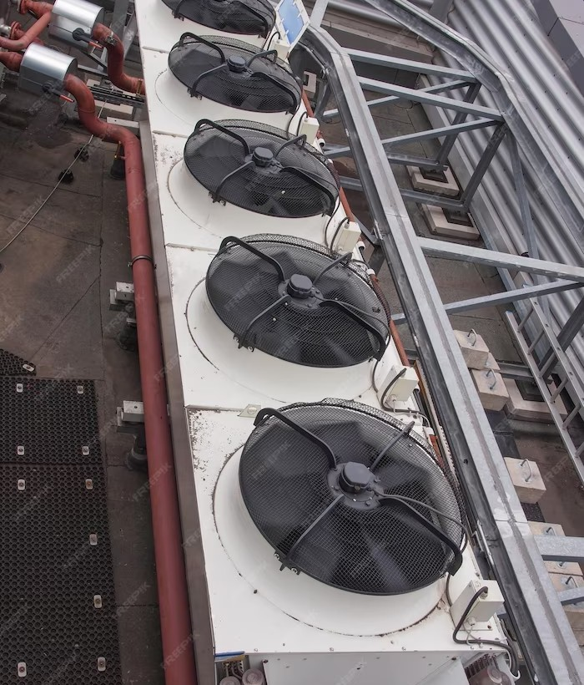
STRATEGIES FOR REDUCING ENERGY CONSUMPTION
There are many strategies that organizations can use to reduce energy consumption. This slide will cover some of the most effective strategies, including upgrading to energy-efﬁcient equipment, optimizing building systems, and implementing behavior change programs. We will also discuss the importance of setting energy reduction goals and tracking progress.

Slide 5
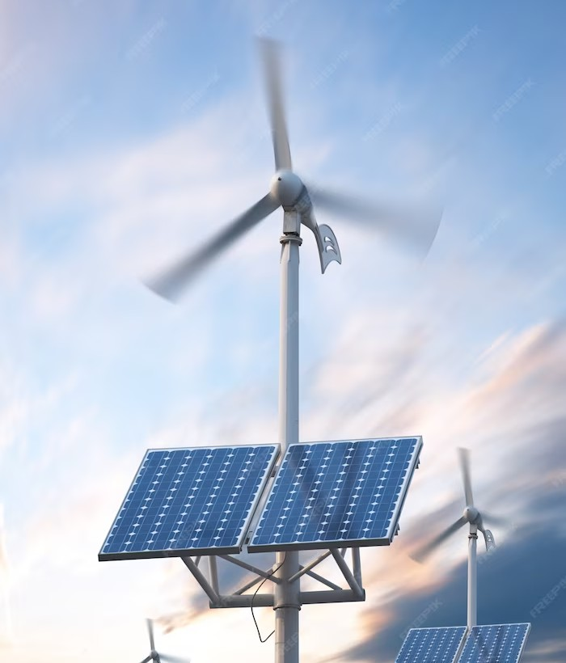
RENEWABLE ENERGY SOURCES
Renewable energy sources are becoming increasingly popular as a way to reduce reliance on fossil fuels and lower energy costs. This slide will cover some of the most common renewable energy sources, including solar, wind, and geothermal. We will discuss the beneﬁts and challenges of each source, as well as the considerations organizations need to make when implementing renewable energy systems.

Slide 6

FINANCING ENERGY EFFICIENCY PROJECTS
Implementing energy efﬁciency projects can require signiﬁcant upfront investment. This slide will
cover some of the ﬁnancing options available to organizations, including grants, loans, and energy performance contracts. We will discuss the pros and cons of each option and provide tips for selecting the best ﬁnancing option for your organization.

Slide 7
CONCLUSION
In conclusion, optimizing energy efﬁciency is a crucial component of any organization's sustainability strategy. By measuring energy consumption, implementing energy-efﬁcient technologies and strategies, and considering renewable energy sources, organizations can reduce costs, lower their environmental impact, and improve their reputation.
Thank you for joining our presentation!

Slide 8
Thanks!

